Slide 1
Spark Streaming
Driver High Availability and
Zero Data Loss

Slide 2
This talk – Agenda
Spark Streaming architecture
Current driver failure handling
Improved driver failure handling
  Saving and recovering received data
  Writing receivers for zero data loss

Slide 3
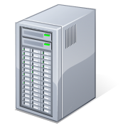
Spark Architecture
Driver node runs application
Worker nodes process data in executors
Executor
Application
Spark
Context
Worker 1
Executor
Driver
Workers

Slide 4
Spark Streaming Architecture
Application runs StreamingContext and an underlying SparkContext
Driver launches Receivers to run as long running tasks on Executors
Executor
Run Receivers as tasks
Receiver
Application
Streaming
Context
Spark
Context
Executor
Driver
Workers

Slide 5
Spark Streaming Architecture
Input stream
Each Receiver receives input stream and divides it into blocks
Blocks stored in Executor memory
Blocks replicated to another executor
Executor
Receiver
Application
Input blocks in memory
Streaming
Context
Replicate blocks
Spark
Context
Executor
Replicas
in memory
Driver
Workers

Slide 6
Spark Streaming Architecture
Input stream
Saved blocks reported to StreamingContext
After every batch interval, StreamingContext treats received blocks as RDDs, and launches Spark jobs on SparkCtxt
Report blocks
Application
Executor
Streaming
Context
Receiver
Jobs
Replicate blocks
Spark
Context
Executor
Driver
Workers

Slide 7
Spark Streaming Architecture
Input stream
SparkContext runs jobs by running tasks to process the blocks in executors’ memory
This cycle continues every batch interval
Report blocks
Application
Executor
Streaming
Context
Receiver
Jobs
Replicate blocks
Spark
Context
Tasks
to process blocks
Executor
Driver
Workers

Slide 8
Recovery from driver failures
Since all the RDD computation is deterministic, all processing state can be recovered by
  Metadata: Recovering DAG of DStream and deterministically regenerate the RDDs
  Data: Input data and all checkpointed RDDs
Spark Streaming “checkpointing” must save both data and metadata

Slide 9
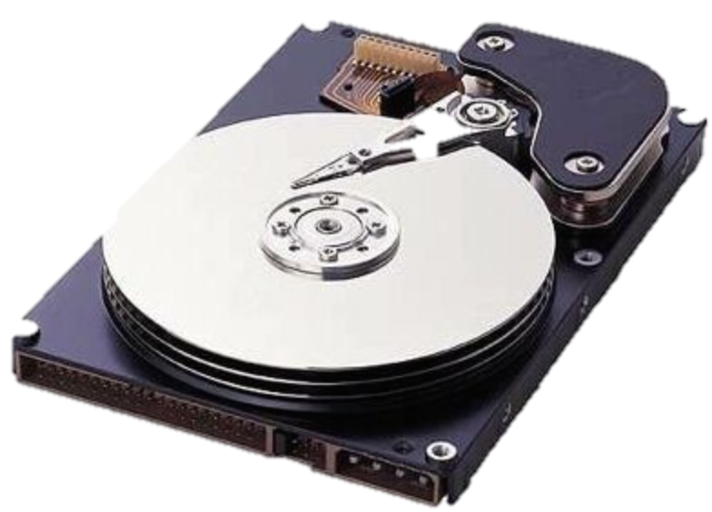
Metadata checkpointing
Received blocks and queue of jobs saved to reliable store after every batch interval
Report blocks
Application
Executor
Streaming
Context
Receiver
Checkpoint metadata
Jobs
Spark
Context
Executor
Driver
HDFS
Workers

Slide 10

Driver Failure
If driver fails, the app is lost & all the executors are lost
Report blocks
Application
Executor
Streaming
Context
Receiver
Checkpoint metadata
Jobs
Spark
Context
Executor
HDFS
Failed
Driver
Workers

Slide 11
Driver Recovery from Checkpoint
Application can be restarted from checkpointed metadata on another driver node
Recover app from metadata
Restarted
Application
Streaming
Context
Spark
Context
HDFS
Failed
Driver
Another Driver

Slide 12
Received in-memory data is lost
Executors are restarted, receivers are restarted but all the in-memory data is lost
Recover app from metadata
Recovered
Application
Executor
Receiver
Streaming
Context
blocks not recovered
Spark
Context
Executor
HDFS
Another Driver
Workers

Slide 13
No Checkpointing of Input Data!
Chances of small data loss on driver failures [Spark 1.1]
  Data received but not processed is lost
  Past batch data needed for stateful operations (window ops, …) will be lost
Top feature request for Spark Streaming in the community

Slide 14
What do we need to do avoid any data loss??
Save (checkpoint) all the received data
  Receive stream and divide into blocks
  Save data and metadata of the blocks to reliable storage
  Acknowledge downstream source correctly
Recover all the received data after restarting
  All the saved data will be recovered from reliable storage
  All the unsaved (therefore unacknowledged) data will have to replayed from the source

Slide 15
What do we need to do avoid any data loss??
Save (checkpoint) all the received data
  Receive stream and divide into blocks
  Save data and metadata of the blocks to reliable storage
  Acknowledge downstream source correctly
How to save and recover data inside Spark Streaming
How to write reliable receivers that ensure zero data loss
Spark
Streaming
Sources with support for acks or transactions
Receivers

Slide 16
How to save and recover data inside Spark Streaming
Spark
Streaming
Sources with support for acks or transactions
Receivers

Slide 17
Write Ahead Log (WAL)
Write Ahead Log: Write any intent of an update to a reliable log file before applying the update
  As long as the intent is stored reliably, the updated can be recovered upon failure
Very common in file systems, databases, etc.
We will use WALs for both data and metadata

Slide 18
Data Checkpointing using WALs
Input stream
Application
Executor
Streaming
Context
Receiver
Replicate blocks
Spark
Context
Executor
Driver
Workers

Slide 19
Data Checkpointing using WALs
Input stream
Write block data to WAL in HDFS
Application
Executor
Streaming
Context
Receiver
Write block data
Spark
Context
Driver
WAL in HDFS

Slide 20
Metadata Checkpointing using WALs
Input stream
Write block data to WAL in a reliable store
Write block metadata to another WAL
Report blocks
Application
Executor
Write block id + WAL segment info
Streaming
Context
Receiver
Write block data
Spark
Context
WAL in HDFS
Driver
WAL in HDFS

Slide 21
Saving everything
Data WAL for saving block data
Metadata WAL for saving block metadata
  Block ID and Data WAL segment info
  Batch to which each block is allocated to

Slide 22
Recovering everything after driver failure
Retrieve block metadata and block-to-batch mapping from the Metadata WAL
Recreate all the RDDs from the blocks and relaunch unfinished jobs
Jobs read data directly from the Data WAL
All Spark Streaming state recovered (almost)

Slide 23
What about data received but not saved?
Data has to be replayed from source
Replayable sources usually have some acknowledgement mechanism for reliable sending
Needs a Reliable Receiver

Slide 24
How to write reliable receivers that ensure zero data loss
Spark
Streaming
Sources with support for acks or transactions
Receivers

Slide 25
Receivers
Receives data from “external systems”
Usually speaks a protocol understood by the external system
Stores data into the BlockManager, and optionally to the HDFS WAL
Optionally “reliable”

Slide 26
What about data received but not saved?
Data has to be replayed from source
Replay-able sources usually have some acknowledgement mechanism for reliable sending
  Kafka: offset for each topic + partition
  Flume: transactions
A reliable receiver must be acknowledge the source only after corresponding blocks have been written to both WALs, on block generation
WAL + Reliable Receiver = No Data Loss!

Slide 27
Receiver API
Extend org.apache.spark.streaming.receiver.Receiver
Initialize and establish connections, start threads to receive data in onStart()
On receiving data, call one of the store() methods to store your data in the Block Manager
Terminate connections, clean up in onStop()

Slide 28
Simple Receiver - Workflow
Receive data from external system
Executor
Receiver
Event Stream
Block Generator
Buffer
Block Manager

Slide 29
Simple Receiver - Workflow
Receive data from external system
For each “event” received – call store()
Executor
Receiver
Event Stream
Individual Events
Block Generator
Buffer
Block Manager

Slide 30
Simple Receiver - Workflow
Receive data from external system
For each “event” received – call store()
Send ACK. Actual storing is asynchronous
Executor
Receiver
Event Stream
Individual Events
ACK
Block Generator
Buffer
Block Manager

Slide 31
Simple Receiver - Workflow
Receive data from external system
For each “event” received – call store()
Send ACK. Actual storing is asynchronous
Events buffered until a preset time interval before actually getting “pushed” to the Block Manager
Executor
Receiver
Event Stream
Individual Events
ACK
Block Generator
Buffer
Block
Block Manager

Slide 32
Simple Receiver - Characteristics
Simplest to implement
Receiver does not know when data is actually pushed
Executor failure – all buffered, but not yet block-ified data is lost!
Data loss even if WAL is enabled
Executor
Receiver
Event Stream
Individual Events
ACK
Block Generator
Buffer
Block
Block Manager

Slide 33
Reliable Receiver - Workflow
Receive data
Executor
Receiver
Event Stream
Block Manager

Slide 34
Reliable Receiver - Workflow
Receive data
Buffer data internally until enough data for a block is received
Or push block for each batch received (if the external system is batch-aware)
Executor
Receiver
Event Stream
Block
Block Manager
Notes:
clarify that this “batch” is different “source batch”

Slide 35
Reliable Receiver - Workflow
Receive data
Buffer data internally until enough data for a block is received
Or push block for each batch received (if the external system is batch-aware)
Executor
Receiver
Event Stream
Block
Block Manager
Push an entire block using
  store(ArrayBuffer), store(Iterator), store(ByteBuffer)

Slide 36
Reliable Receiver - Workflow
Receive data
Buffer data internally until enough data for a block is received
Or push block for each batch received (if the external system is batch-aware)
Executor
Receiver
Event Stream
ACK
Block
Block Manager
Push an entire block using
  store(ArrayBuffer), store(Iterator), store(ByteBuffer)
ACK once store() returns
Notes:
ACK once store() call returns

Slide 37
Reliable Receiver – Characteristics
Reliable – no data loss on driver or executor failure
“Less simple” to implement – depends on source type
No Rate Limiting
Depending on batch-size, each block may be too big or too small
Can create too many blocks or too few blocks per Streaming batch
Executor
Receiver
Event Stream
ACK
Block
Block Manager
Notes:
if source has batches .. easy ..Flume
If no, Kafka, not easy

Slide 38
Which workflow to use for my receiver?
Depends on your requirements
  Simple Receiver: Simple to write, but no guarantees
  Reliable Receiver: Guaranteed to be reliably stored
To ensure there is no data loss:
  Enable WAL for your application via configuration
  Use a Reliable Receiver to receiver data

Slide 39
End-to-end Driver Recovery Guarantees
 | Spark 1.1- or Spark 1.2 w/o WAL | Spark 1.2 with WAL + Simple Receiver | Spark 1.2 with WAL + Reliable Receiver
Data received but not saved | Lost | Lost | Recovered
Data saved but not processed |  | Recovered | Recovered
Kafka and Flume – see docs for configuring with WAL

Slide 40
How do I set up Driver HA???

Slide 41
Setting up Driver HA [Spark 1.1]
Write your streaming application such that it can be restarted any time
  Set checkpoint directory using StreamingContext.checkpoint(<HDFS dir>)
  Create or restart StreamingContext using StreamingContext.getOrCreate(...)
Configure your infrastructure to automatically restart streaming app if it fails
  Spark standalone – submit in cluster mode with –supervise
  YARN – submit in cluster mode
  Mesos – submit using Marathon

Slide 42
Setting up Driver HA + WAL [Spark 1.2]
Write your streaming application such that it can be restarted any time
Configure your infrastructure to automatically restart streaming app if it fails
Optionally, enable WAL
  Set SparkConf configuration spark.streaming.receiver.writeAheadLog.enable to true

Slide 43
Performance Considerations
Can reduce throughput-per-receiver when enabled
  Limited by disk throughput and network bandwidth used for HDFS replication
  Will improve in later releases
Run multiple receivers to increase aggregate throughput

Slide 44
Roadmap
Spark 1.2
  WAL based driver recovery
  Basic Python API
  Streaming KMeans
Spark 1.3 and beyond
  Improvements to the driver recovery – performance and stability
  KafkaUtils, FlumeUtils, etc. in Python API
  Make Receiver API easier to use

Slide 45
Write Ahead Log
+
Reliable Receiver
=
Spark Streaming Driver HA
with zero data loss

Slide 46
Driver Recovery Guarantees
Spark 1.1, Spark 1.2 without WAL
  Data received but not processed will be lost
  Past data for stateful ops (window, etc.) will be lost
Spark 1.2 with WAL and Unreliable Source/Simple Receiver
  Data saved to WAL and past data will be recovered
  Data received but not yet saved to WAL will be lost
Spark 1.2 with WAL and Reliable Source + Receiver
  All data recovered or replayed, zero data loss

